Slide 1
Using Python Documentation
Brandon Krakowsky

Slide 2
Using Python Documentation

Slide 3
Using Python Documentation
Let’s say you have a list my_list = [1, 2, 3, ‘four’, ‘five’, ‘six’]
And you’d like to get the index of ‘four’
But you don’t know how to do it …
One way is to consult the online Python documentation

Slide 4
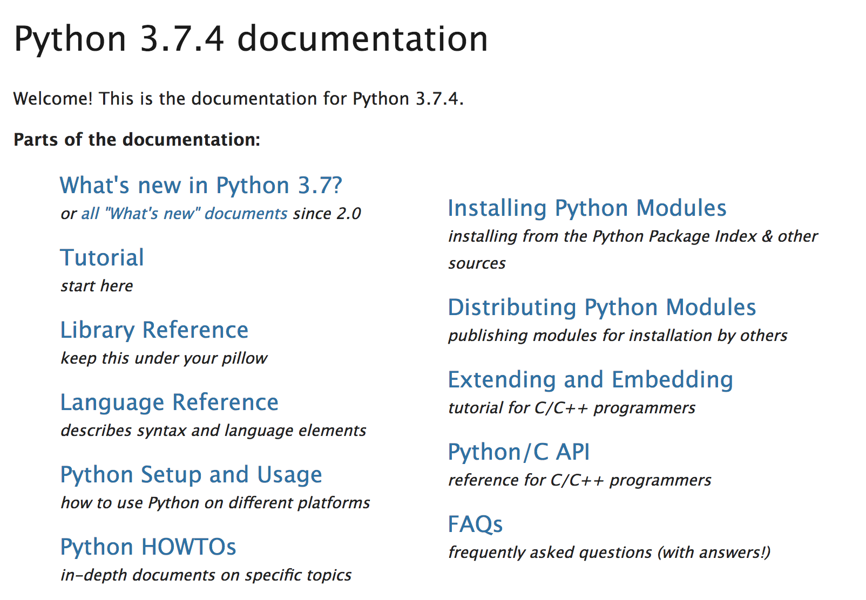
Using Python Documentation
Go here: https://docs.python.org/3/
One way to quickly find info is via the “Tutorial” link, above where it says “start here”

Slide 5
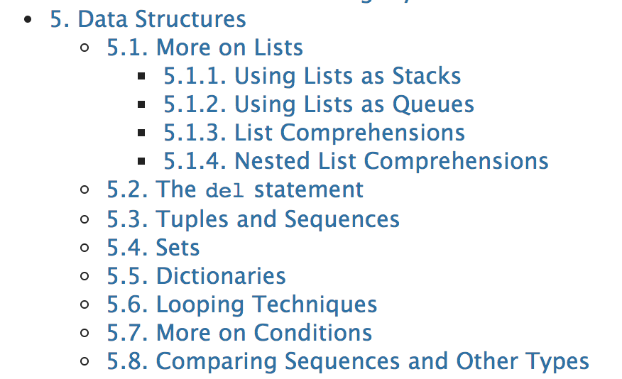
Using Python Documentation
If you scroll down, you’ll find “More on Lists” under “Data Structures”
Let’s click that to see what we find

Slide 6
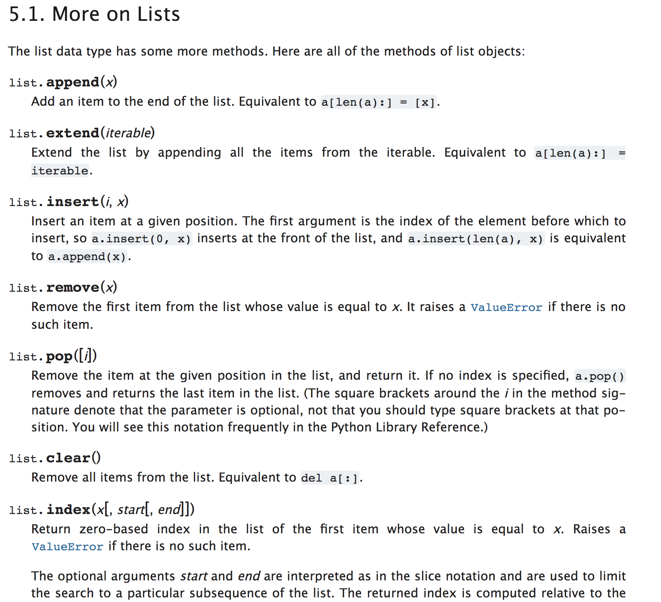
Using Python Documentation
If you scroll down, you’ll find information about various list methods
You should find list.index(x)
This will return the index of the first item x in a list

Slide 7
Using Python Documentation
Here’s our list again my_list = [1, 2, 3, ‘four’, ‘five’, ‘six’]
Now let’s get the index of ‘four’ using the index method my_list.index(‘four’)
You should receive 3

